Slide 1

Dijkstra’s Super Speedy Solver
Ren Young
CS 315
12/1/2020

Slide 2
Abstract
Video Game Speed Running
Completing a game as quickly as possible
Goal: Video game speed runner path finder
Dijkstra’s algorithm
SSSP
Helpful for speed runners

Slide 3
Problem statement
Video Game Speed Running
Completion of a game as quickly as possible
Necessary aspects
Knowledge of the game
Plan for path of action
Skills in game
Project Focus: Plan for path of action
DAG
Find Best Path
Based on input info from user

Slide 4

Why Do We Care About This Problem?
Important in speed running community
-Determines true possibility
Help in determining best paths
-Allows for different focus for speed runners
Importance
-Games Done Quick marathons
-28+ million dollars raised
-Fun!

Slide 5

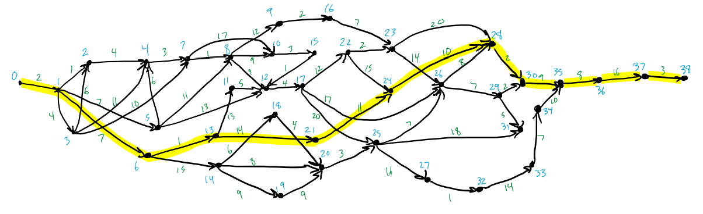
Examples
Minecraft
Candy Crush Piece
Popular game
Common speed run challenge
Many options for user actions
Even smaller version shown below is complex
One possible ending, many paths
Level-based
Advancement based on completion of defined tasks
Piece – 1st 10 Levels
Simple Graph

Slide 6
Solution & Algorithms
Parameters
DAG
Edge – difficulty/time/complexity of task
Vertex – Tasks
User defines start & end
Some Algorithm Considerations
Dijkstra’s algorithm
single source
shortest path
Decision: Dijkstra’s algorithm

Slide 7
Complexity, Properties, Interesting facts
Complexity
Properties
Interesting Facts
Dijkstra
Big – Θ:
Θ(|V|²)
|V|: number of vertices
Implementation -> Finds path to every other vertex
Finds total distance: value associated with end node
Dijkstra designed the algorithm in ~20 minutes
Games Done Quick – largest fundraising event for 2 charities

Slide 8
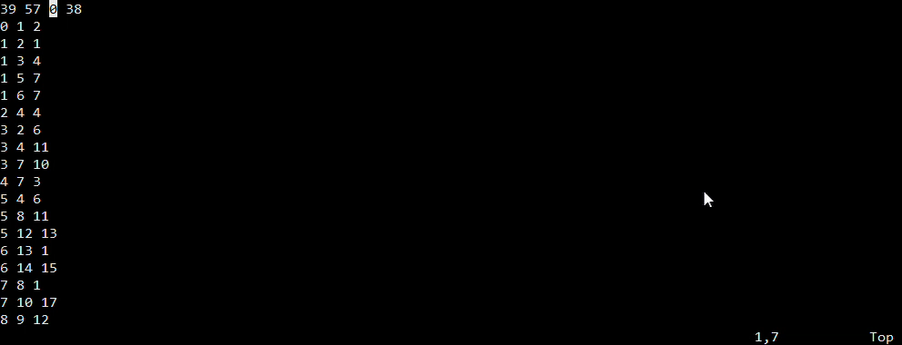
Implementation/Demo
2. Start loop through nodes,
Find unvisited node with min distance
3. Compare with unvisited node distances
1. Read in graph info
Play video

Slide 9
Conclusions
Difficulty in design: complicated to define steps in some games
Difficulty with algorithm: determining how to contain data
Array? Set? Heap?
Future work
List multiple paths
Allow for multiple ending steps
Sources
https://en.wikipedia.org/wiki/Dijkstra%27s_algorithm#Pseudocode
https://www.tutorialspoint.com/cplusplus-program-for-dijkstra-s-shortest-path-algorithm
https://gamesdonequick.com/

